Slide 1

High Impact Skills Development Program
in Artificial Intelligence, Data Science, and Blockchain
Module 1: AI Fundamentals
Nearest Neighbour Classifier
Instructor: Dr Latif Anjum
NUST – SEECS

Slide 2
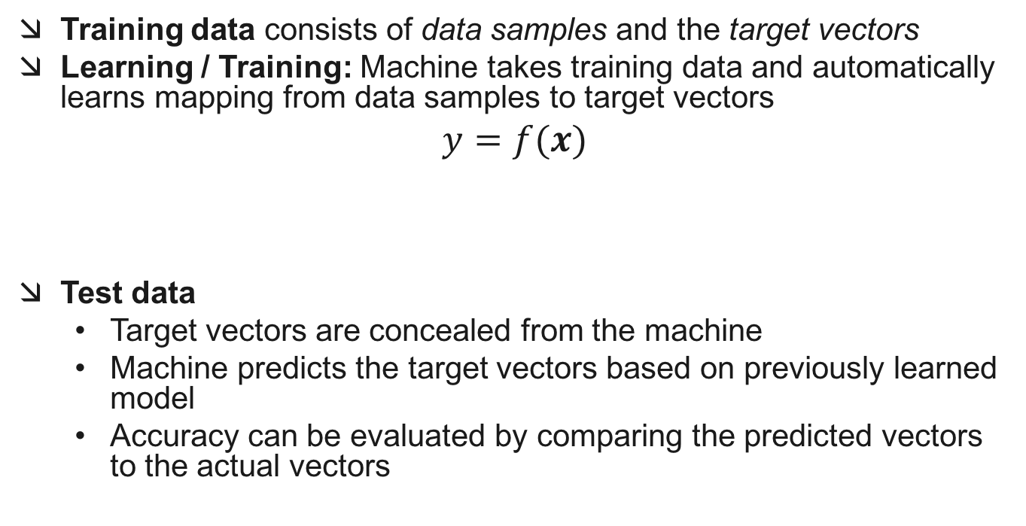
The Machine Learning Framework
Training data consists of data samples and the target vectors
Learning / Training: Machine takes training data and automatically learns mapping from data samples to target vectors
$$y=f(x)$$
Test data
Target vectors are concealed from the machine
Machine predicts the target vectors based on previously learned model
Accuracy can be evaluated by comparing the predicted vectors to the actual vectors
Output Label
Feature vector
Prediction Function

Slide 3
Supervised Learning
Linear Regression
Classification

Slide 4
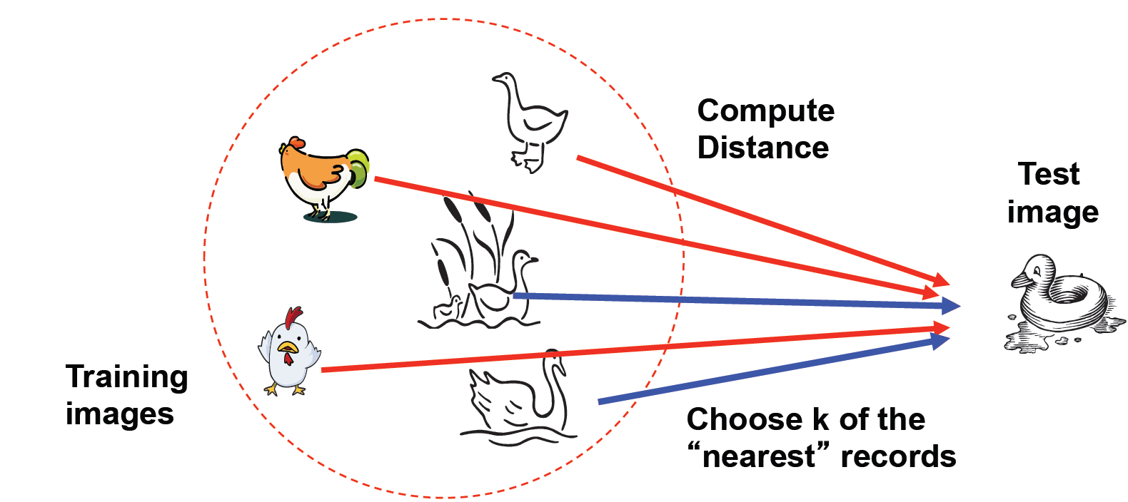
Nearest Neighbour Classifier
Assign label of nearest training data point to each test data point

Slide 5
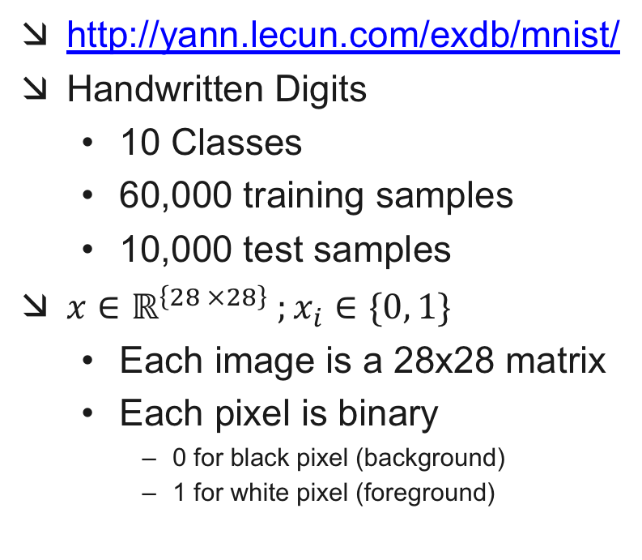
THE MNIST DATABASE
http://yann.lecun.com/exdb/mnist/
Handwritten Digits
10 Classes
60,000 training samples
10,000 test samples
$x∈ℝ^{\left\{28 ×28\right\}} ;x_{i}∈\{0, 1\}$
Each image is a 28x28 matrix
Each pixel is binary
0 for black pixel (background)
1 for white pixel (foreground)

Slide 6


Converting an Image to a Feature Vector
Vectorize the image matrix (column wise concatenation)
$x∈ℝ^{748} ;x_{i}∈\{0, 1\}$
e.g. $x={\left[0 0 1 1 ⋯0\right]}^{T}$ may represent
$y=f(x)$

Slide 7

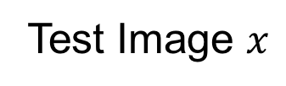

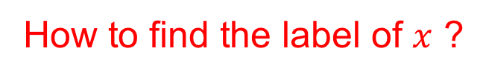
Image Classification
Consider your training images: ${x_{1},x_{2},…,x}_{t}$ with their corresponding labels $y_{1},y_{2},…, y_{t}$
Test Image $x$
How to find the label of $x$ ?

Slide 8
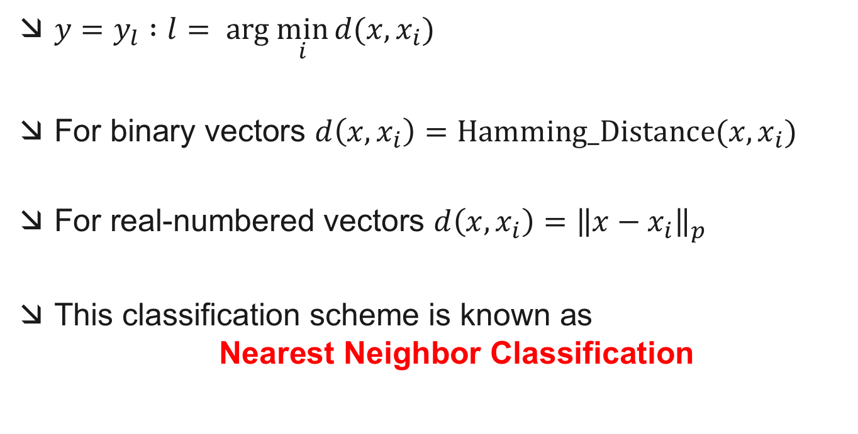
Minimum Distance Classification
$y=y_{l} :l= arg \min_{i}{d(x,x_{i})}$
For binary vectors $d\left(x, x_{i}\right)=Hamming_Distance(x,x_{i})$
For real-numbered vectors $d\left(x, x_{i}\right)={\left\|x−x_{i}\right\|}_{p}$
This classification scheme is known as Nearest Neighbor Classification

Slide 9
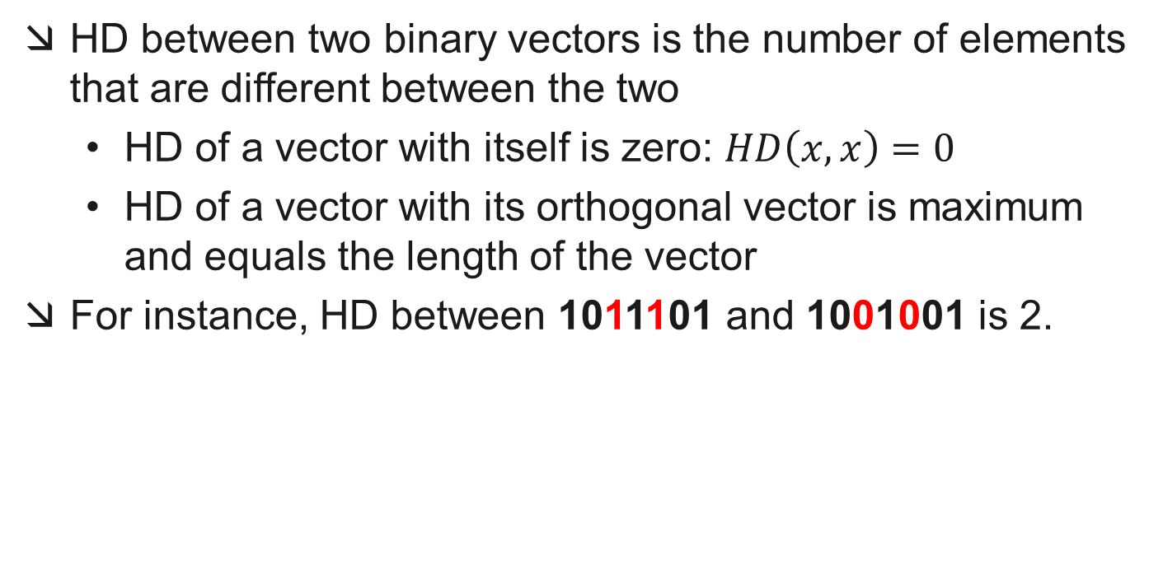
Hamming Distance (HD) Revisited
HD between two binary vectors is the number of elements that are different between the two
HD of a vector with itself is zero: $HD\left(x,x\right)=0$
HD of a vector with its orthogonal vector is maximum and equals the length of the vector
For instance, HD between 1011101 and 1001001 is 2.

Slide 10
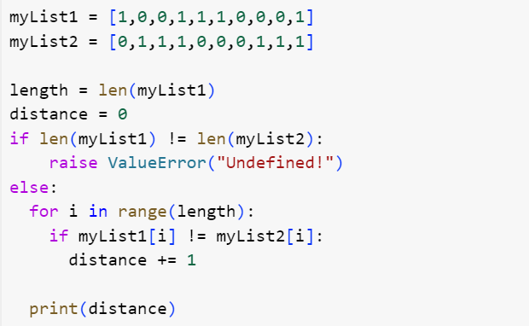
Hamming Distance (HD)

Slide 11
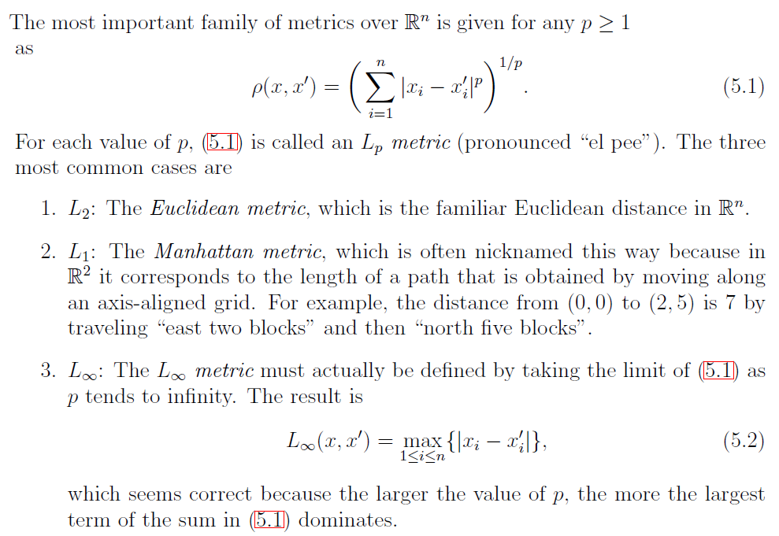

$l_{p}$ Norms

Slide 12
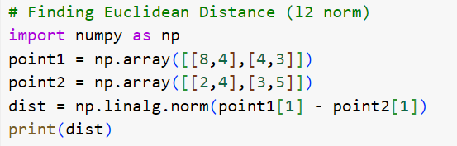
$l_{p}$ Norms

Slide 13
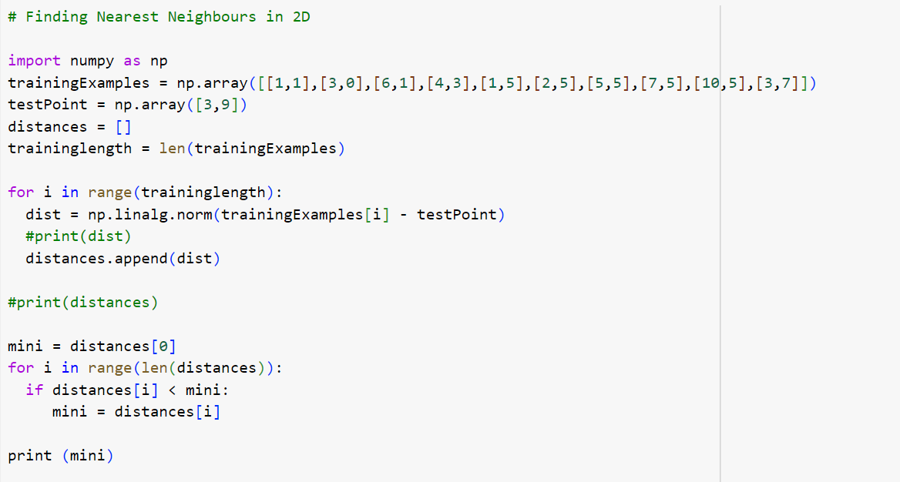
$l_{p}$ Norms

Slide 14
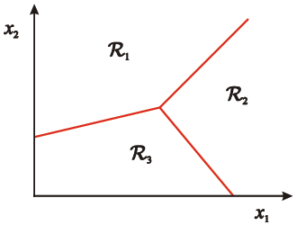
Decision Boundaries of 1NN Classifier
Assign input vector to one of two or more classes
Any decision rule divides input space into decision regions separated by decision boundaries

Slide 15
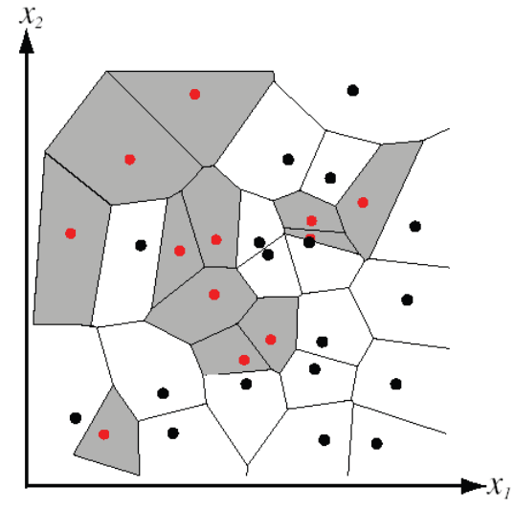
Voronoi Diagram for 1NN Decision Boundaries
Partitioning of feature space for two-category 2D data using 1-nearest-neighbor is achieved using Voronoi Diagram

Slide 16
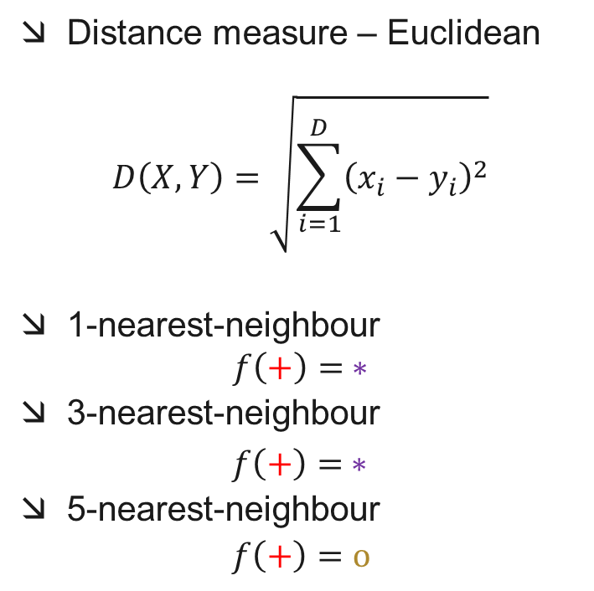
K-nearest-neighbor Classification
Distance measure – Euclidean
$$D\left(X,Y\right)=\sqrt{\sum_{i=1}^{D}{{\left(x_{i}−y_{i}\right)}^{2}}}$$
1-nearest-neighbour
$$f\left(+\right)= ∗$$
3-nearest-neighbour
$f\left(+\right)= ∗$
5-nearest-neighbour
$f\left(+\right)=o$
x₂
o
+
*
*
*
*
*
*
o
o
*
*
*
o
*
o
*
o
*
o
o
o
x₁

Slide 17
K-NN Practical Matters
Choosing the value of k
If too small, sensitive to noise points
If too large, neighborhood may include points from other classes
Solution: cross-validation
Can produce counter-intuitive results
Each feature may have a different scale
Solution: normalize each feature to zero mean, unit variance
Curse of dimensionality
Solution: no good solution exists so far
This classifier works well provided there are lots of training data and the distance function is good.

